Slide 1
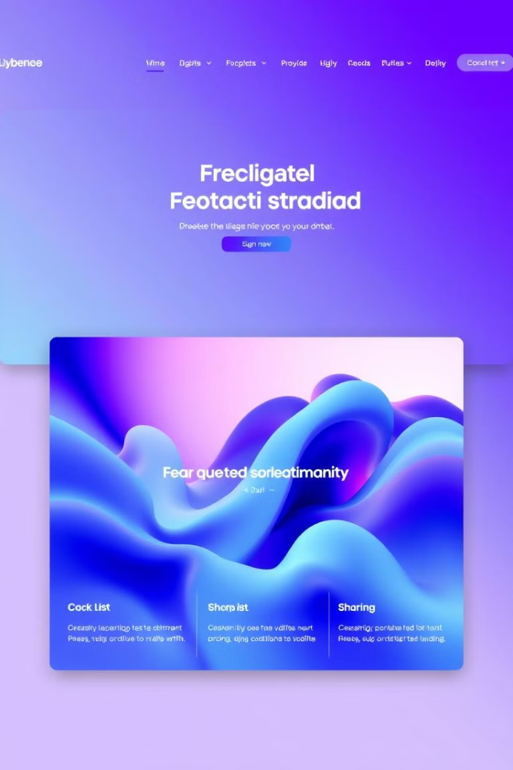
Art Web: Unleash Your Creative Potential
Welcome to Art Web, the premier online platform for discovering, showcasing, and selling exceptional artwork. Dive into a world of artistic expression and connect with a community of passionate creators and art enthusiasts.

Slide 2
Introducing the Art Web Experience
Robust Artist Profiles
Intuitive Navigation
Secure Transactions
Each artist has a dedicated profile page to showcase their portfolio, share their story, and engage with collectors.
Seamless browsing and discovery through our curated categories and advanced search functionality.
Streamlined and secure payment options to facilitate hassle-free art purchases.

Slide 3

Selling Paintings on Art Web
Commission-Free Sales
Global Reach
Connect with art enthusiasts worldwide and expand your collector base through our global online presence.
Art Web offers a commission-free platform, allowing artists to keep 100% of their sales proceeds.
Intuitive Tools
Utilize our user-friendly tools to manage your inventory, track sales, and engage with collectors.

Slide 4




Showcasing Diverse Art Styles

Slide 5

Upcoming Art Exhibitions
1
Nature-Inspired Art
Celebrate the beauty of the natural world through a captivating collection of landscape paintings and botanical illustrations.
2
Digital Art Showcase
Immerse yourself in the cutting-edge world of digital art, featuring innovative and technologically-driven works.
3
Emerging Artists Exhibit
Discover the next generation of artistic talent in our juried exhibition highlighting the work of up-and-coming creators.

Slide 6




The Future of Art Web
Enhanced Artist Tools
Innovative features to streamline the creative and business aspects of an artist's practice.
Augmented Reality Integration
Allowing collectors to virtually experience and envision artwork in their own spaces.
Blockchain-Powered Authentication
Secure and transparent ownership tracking to enhance trust and provenance in the art market.

